Slide 3
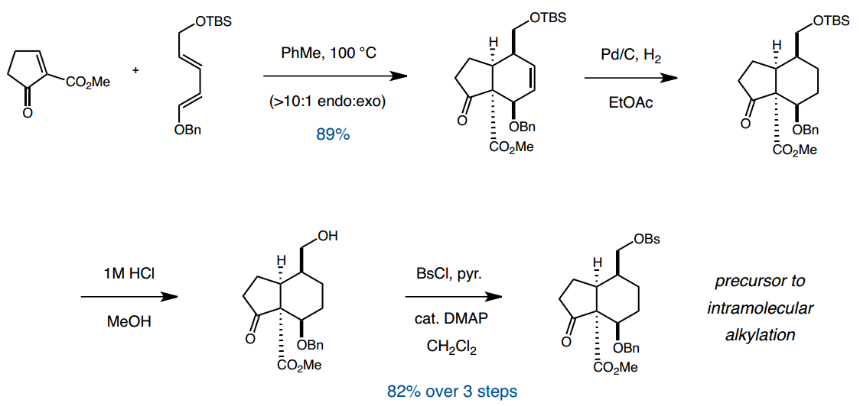

Slide 5
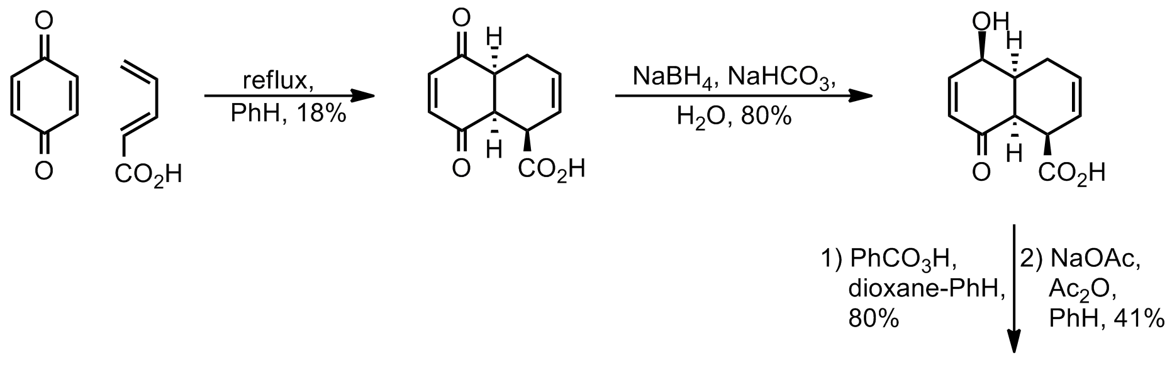
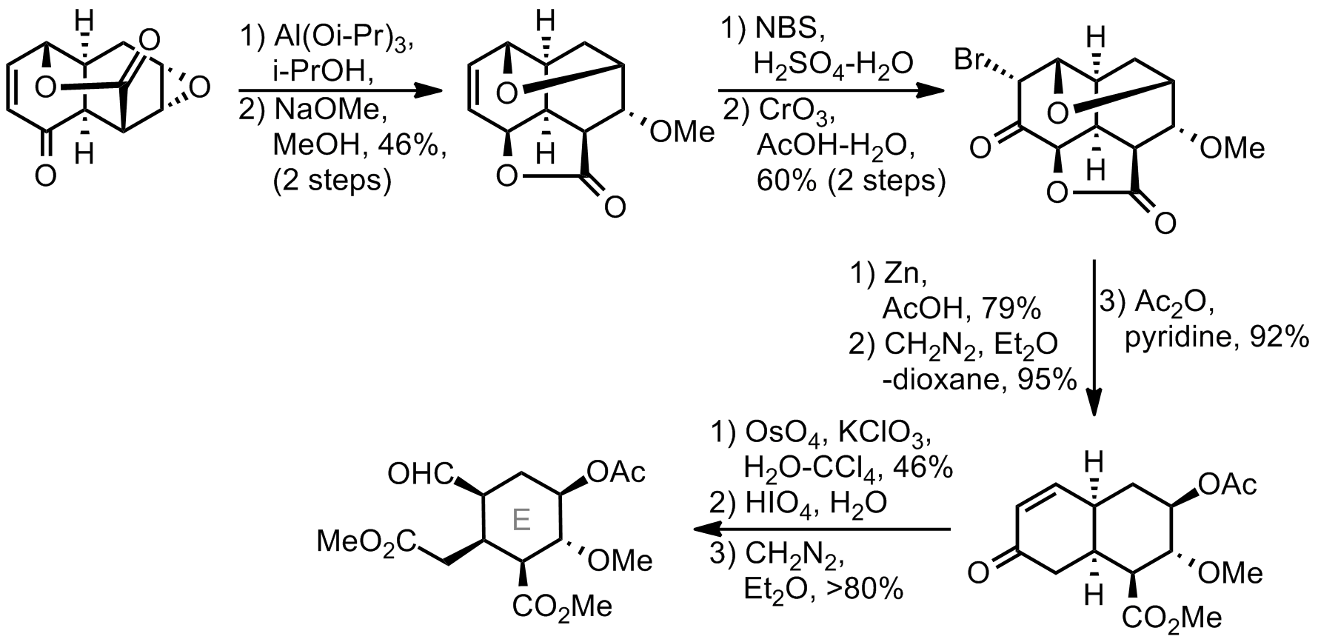
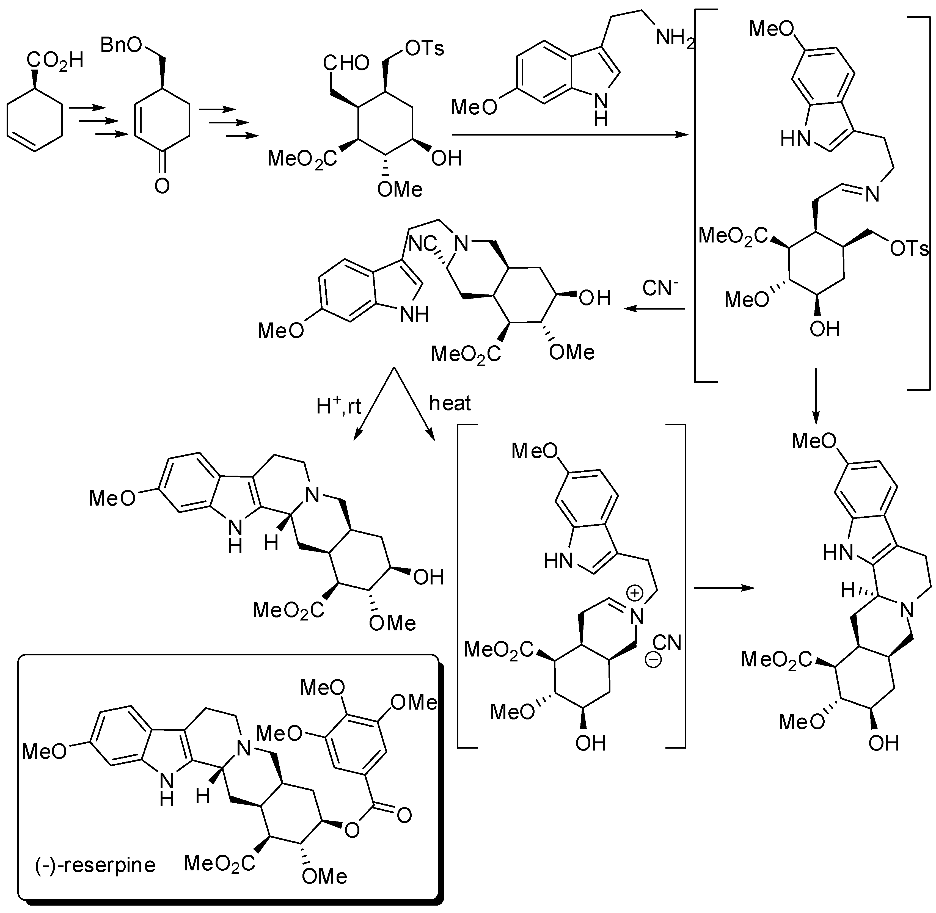

Slide 6
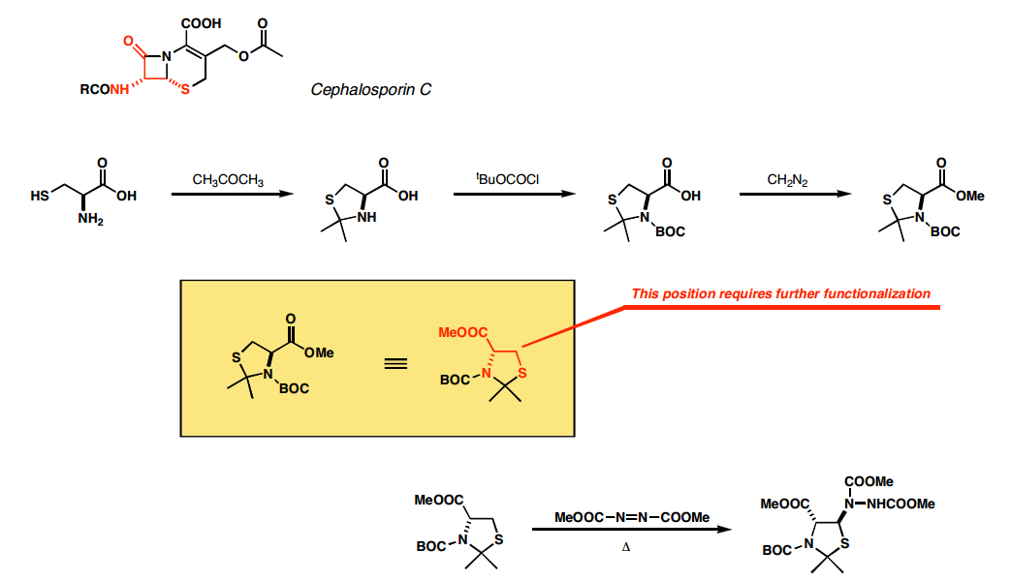

Slide 8
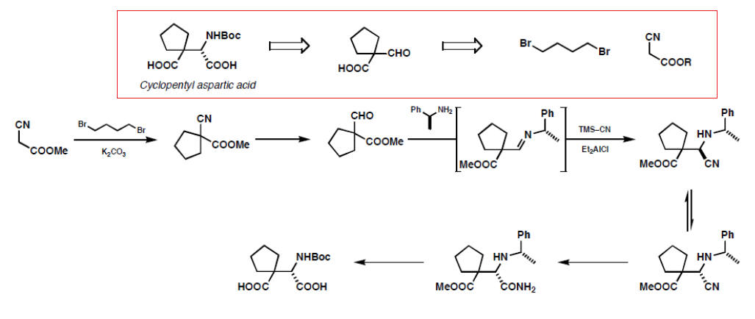

Slide 9
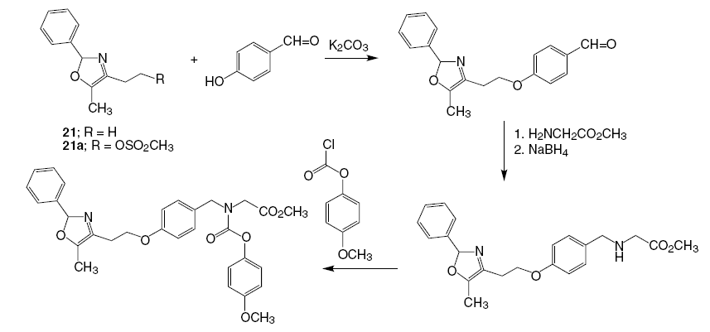
Muraglitazar

Slide 10
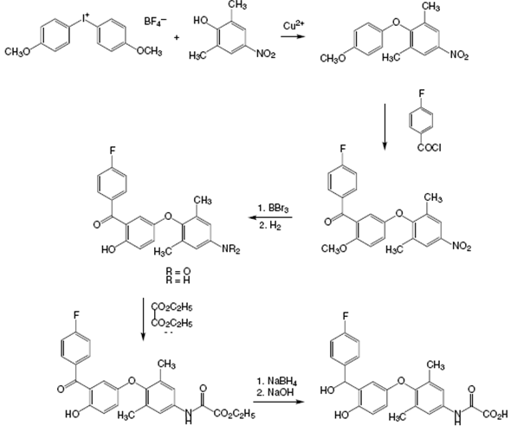
Axitirome (lipid lowering )
boron tribromide
then serves to cleave
the methyl ether
ethyl oxalate
carbonyl group is then reduced to the corresponding alcohol;
oxamic ester

Slide 11
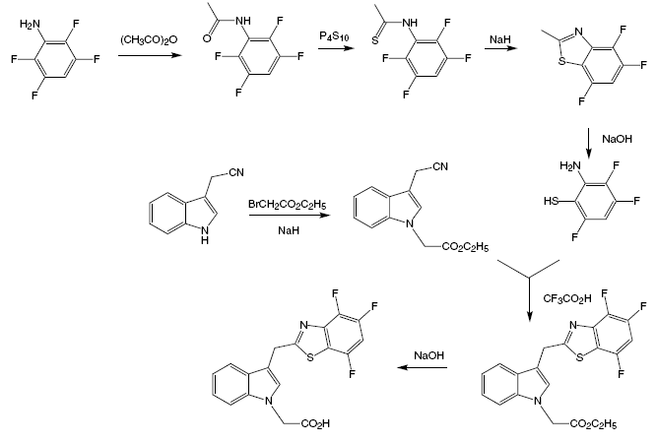
Lidorestat for diabetes
sodium hydride produces
the sulfide anion from the enol form of the thioamde.
benzothiazole
acylated with
acetic anhydride.
hydrolysis opens the ring to afford the intermediate mercapto aniline,

Slide 12
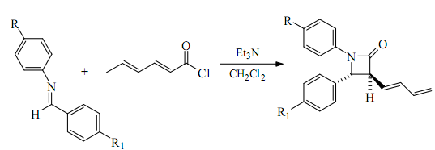
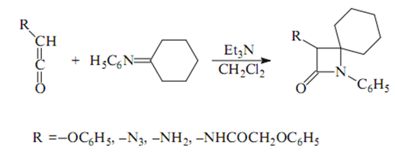
Synthesis methods of β-Lactam

Slide 14
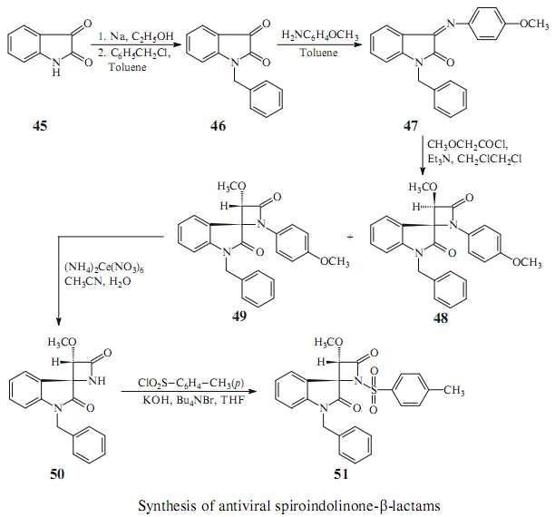
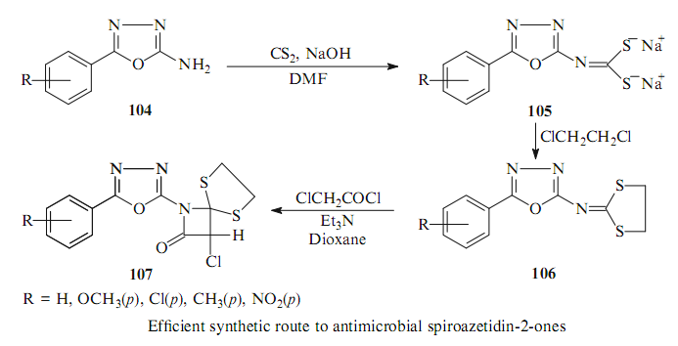

Slide 15
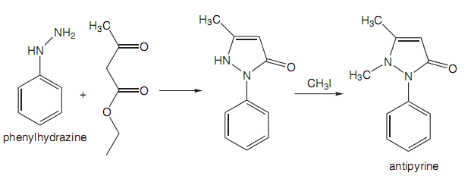
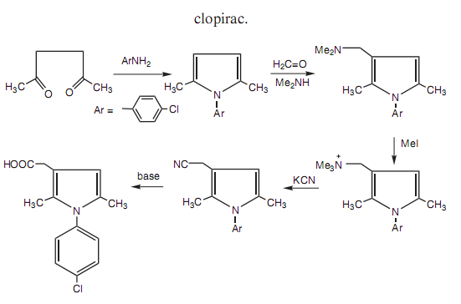

Slide 16
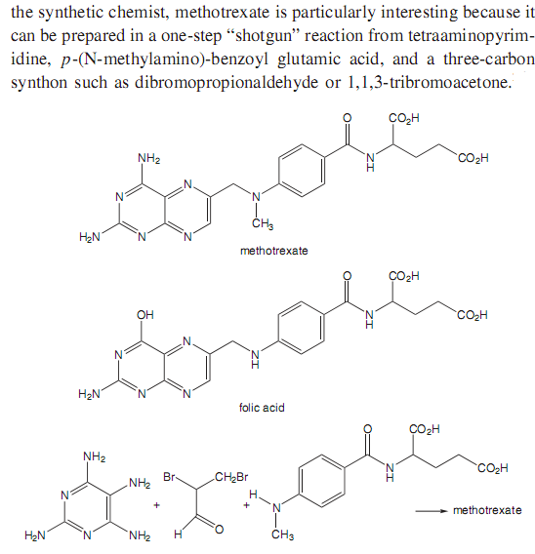

Slide 17
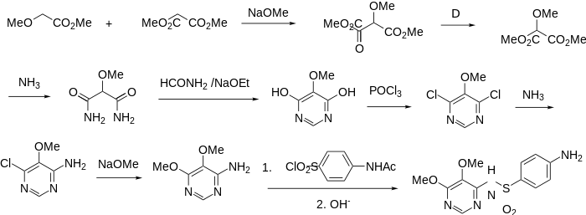
Sulfadoxine

